Slide 1

Logistic Regression
Dr Mehrdad Ghaziasgar
Senior Lecturer in Computer Science
Department of Computer Science
University of the Western Cape
mghaziasgar@uwc.ac.za

Slide 2
Content
Part 1:
Classification With Logistic Regression
Model Evaluation For Classification
Part 2:
Overfitting and Underfitting
Part 3:
Practical Issues With Classification

Slide 3
Content – Part 1
Classification With Logistic Regression
Model Representation
Obtaining the Decision Boundary
Cost Function
Cost Function Minimization For Classification
Model Evaluation For Classification
Accuracy
Precision and Recall
F1 score

Slide 4
Classification With Logistic Regression
Model Representation
Classification With Logistic Regression
Model Representation
Obtaining the Decision Boundary
Cost Function
Cost Function Minimization For Classification
Multi-Class Classification
Model Evaluation For Classification
Accuracy
Precision and Recall
F1 score

Slide 5

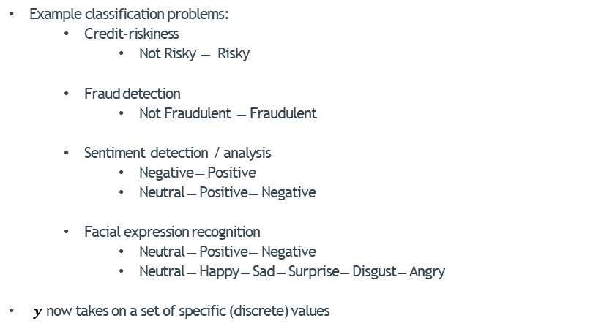





Classification With Logistic Regression
Example classification problems:
Credit-riskiness
Not Risky ̶ Risky
Fraud detection
Not Fraudulent ̶ Fraudulent
Sentiment detection / analysis
Negative ̶ Positive
Neutral ̶ Positive ̶ Negative
Facial expression recognition
Neutral ̶ Positive ̶ Negative
Neutral ̶ Happy ̶ Sad ̶ Surprise ̶ Disgust ̶ Angry
$y$ now takes on a set of specific (discrete) values
$$y ε \left\{0,1\right\}$$
$$y ε \left\{0,1\right\}$$
Classification With Logistic Regression
$$y ε \left\{0,1\right\}$$
$$y ε \left\{0,1,2\right\}$$
$$y ε \left\{0,1,2 \right\}$$
$$y ε \left\{0,1,2,3,4,5\right\}$$

Slide 6
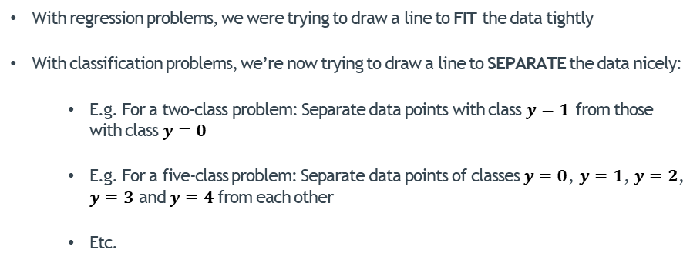
Classification With Logistic Regression
With regression problems, we were trying to draw a line to FIT the data tightly
With classification problems, we’re now trying to draw a line to SEPARATE the data nicely:
E.g. For a two-class problem: Separate data points with class $y=1$ from those with class $y=0$
E.g. For a five-class problem: Separate data points of classes $y=0$, $y=1$, $y=2$, $y=3$ and $y=4$from each other
Etc.
Classification With Logistic Regression

Slide 7
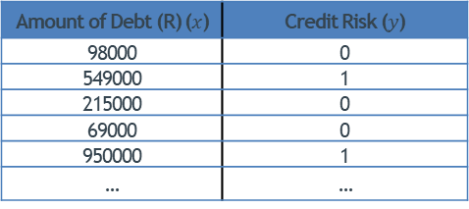
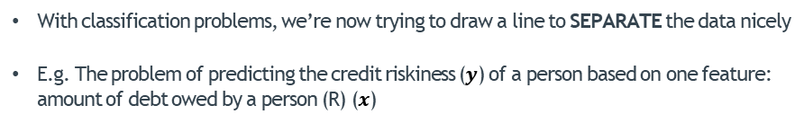
Classification With Logistic Regression
With classification problems, we’re now trying to draw a line to SEPARATE the data nicely
E.g. The problem of predicting the credit riskiness ($y$) of a person based on one feature: amount of debt owed by a person (R) ($x$)
Classification With Logistic Regression
Amount of Debt (R) ($x$) | Credit Risk ($y$)
98000 | 0
549000 | 1
215000 | 0
69000 | 0
950000 | 1
… | …
Training set of credit riskiness

Slide 8


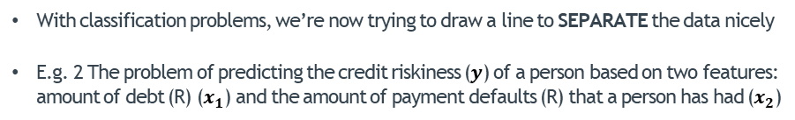



Classification With Logistic Regression
With classification problems, we’re now trying to draw a line to SEPARATE the data nicely
E.g. 2 The problem of predicting the credit riskiness ($y$) of a person based on two features: amount of debt (R) ($x_{1}$) and the amount of payment defaults (R) that a person has had ($x_{2}$)
“Decision Boundary”
Classification With Logistic Regression
$y=1$
Predict $y=0$
Predict $y=1$
$y=0$
0
Amount of Debt (R) $x$

Slide 9
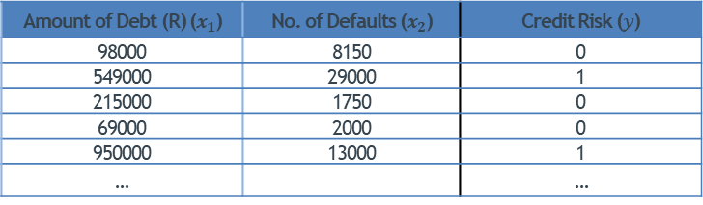
Classification With Logistic Regression
With classification problems, we’re now trying to draw a line to SEPARATE the data nicely
E.g. 2 The problem of predicting the credit riskiness ($y$) of a person based on two features: amount of debt (R) ($x_{1}$) and the amount of payment defaults (R) that a person has had ($x_{2}$)
Classification With Logistic Regression
Amount of Debt (R) ($x_{1}$) | No. of Defaults ($x_{2}$) | Credit Risk ($y$)
98000 | 8150 | 0
549000 | 29000 | 1
215000 | 1750 | 0
69000 | 2000 | 0
950000 | 13000 | 1
… |  | …
Amount of Debt (R) ($x$) | Credit Risk ($y$)
98000 | 0
549000 | 1
215000 | 0
69000 | 0
950000 | 1
… | …
Training set of credit riskiness

Slide 10



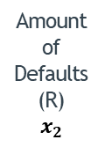


Classification With Logistic Regression
With classification problems, we’re now trying to draw a line to SEPARATE the data nicely
E.g. 2 The problem of predicting the credit riskiness ($y$) of a person based on two features: amount of debt (R) ($x_{1}$) and the amount of payment defaults (R) that a person has had ($x_{2}$)
“Decision Boundary”
Classification With Logistic Regression
Amount of Defaults (R)
$$x_{2}$$
Predict
$$y=0$$
$y=1$
$y=0$
Predict
$$y=1$$
Amount of Debt (R)${ x}_{1}$

Slide 11


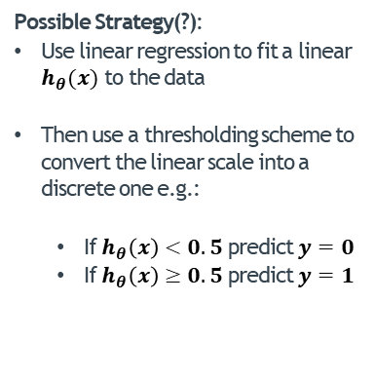

The Problem With Linear Regression
Possible Strategy(?):
Use linear regression to fit a linear $h_{θ}(x)$ to the data
Then use a thresholding scheme to convert the linear scale into a discrete one e.g.:
If $h_{θ}\left(x\right)<0.5$ predict$y=0$
If $h_{θ}\left(x\right)≥0.5$ predict$y=1$
(Yes) 1
$$h_{θ}(x)=θ_{0}+θ_{1}x$$
Credit Risky $y$
Classification With Logistic Regression
(No) 0
Amount of Debt (R) $x$

Slide 12
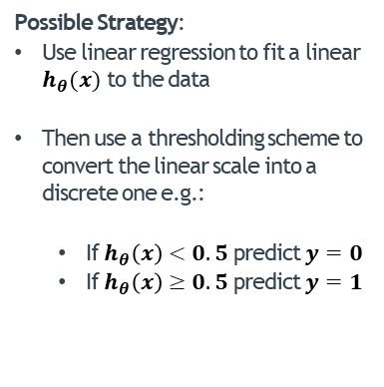

The Problem With Linear Regression
Possible Strategy:
Use linear regression to fit a linear $h_{θ}(x)$ to the data
Then use a thresholding scheme to convert the linear scale into a discrete one e.g.:
If $h_{θ}\left(x\right)<0.5$ predict$y=0$
If $h_{θ}\left(x\right)≥0.5$ predict$y=1$
(Yes) 1
Credit Risky $y$
$$h_{θ}(x)=θ_{0}+θ_{1}x$$
Classification With Logistic Regression
(No) 0
Amount of Debt (R) $x$

Slide 13
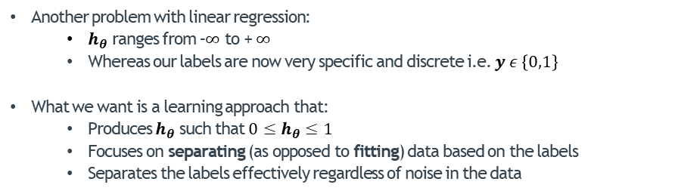
The Problem With Linear Regression
Another problem with linear regression:
$h_{θ}$ ranges from –$∞$ to + $∞$
Whereas our labels are now very specific and discrete i.e. $y ε \left\{0,1\right\}$
What we want is a learning approach that:
Produces $h_{θ}$ such that${0≤h}_{θ}≤1$
Focuses on separating (as opposed to fitting) data based on the labels
Separates the labels effectively regardless of noise in the data
Classification With Logistic Regression

Slide 14
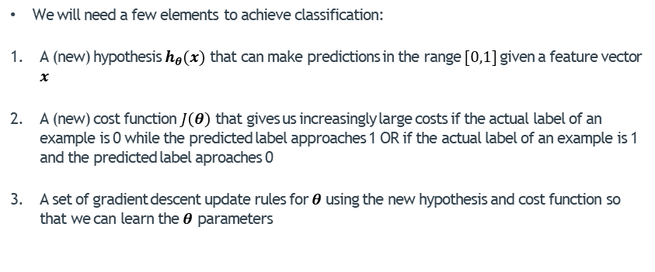
Classification With Logistic Regression
We will need a few elements to achieve classification:
A (new) hypothesis $h_{θ}(x)$ that can make predictions in the range $[0,1]$given a feature vector $x$
A (new) cost function $J\left(θ\right)$ that gives us increasingly large costs if the actual label of an example is 0 while the predicted label approaches 1 OR if the actual label of an example is 1 and the predicted label aproaches 0
A set of gradient descent update rules for $θ$using the new hypothesis and cost function so that we can learn the $θ$ parameters
Classification With Logistic Regression

Slide 15
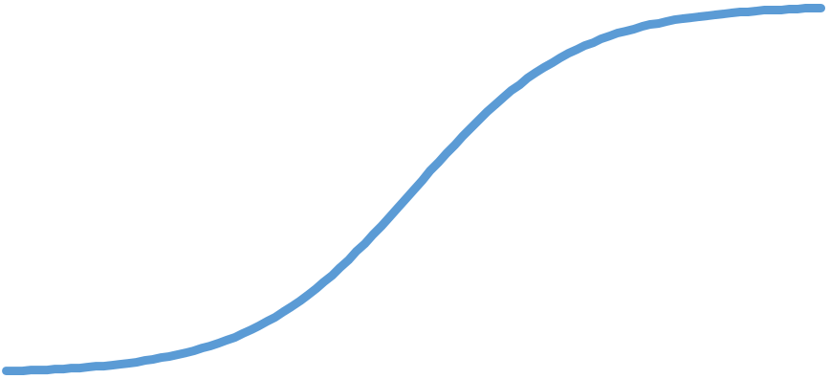



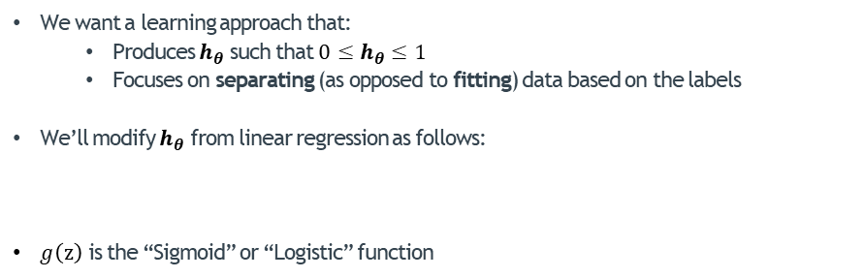




Model Representation
We want a learning approach that:
Produces $h_{θ}$ such that${0≤h}_{θ}≤1$
Focuses on separating (as opposed to fitting) data based on the labels
We’ll modify $h_{θ}$ from linear regression as follows:
$g\left(z\right)$ is the “Sigmoid” or “Logistic” function
Classification With Logistic Regression
$$g( {θ }^{T}x )$$
$${θ }^{T}x$$
$$h_{θ}\left(x\right)=$$
$$θ_{0}x_{0}+θ_{1}x_{1}+θ_{2}x_{2}+…+θ_{n}x_{n}$$
1
$$g(z)$$
$$g\left(z\right)=\frac{1}{1+e^{−z}}$$
0.5
0
$$z$$

Slide 16







Model Representation
$$g\left(z\right)=\frac{1}{1+e^{−z}}$$
Note that $g(z)$ is exactly in the range we want i.e. $0≤g(z)≤1$:
If $z$ is large e.g. 100 then:
If $z$ is very small e.g. -100000 then:
So now:
So:
$$g\left(100000\right)=\frac{1}{1+e^{−100000}}≈\frac{1}{1+0}≈1$$
Classification With Logistic Regression
$$g\left(−100000\right)=\frac{1}{1+e^{100000}}≈\frac{1}{1+∞}≈0$$
1
$$h_{θ}\left(x\right)=g( {θ }^{T}x )$$
$$h_{θ}\left(x\right)$$
0.5
$$h_{θ}\left(x\right)=\frac{1}{1+e^{−{θ }^{T}x}}$$

Slide 17
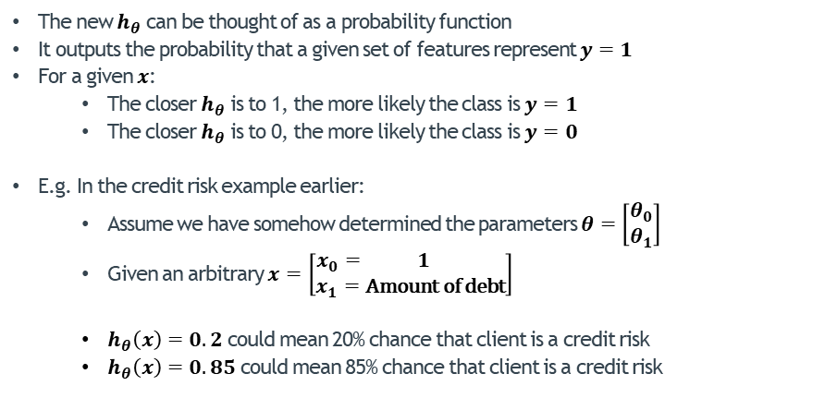
Model Representation – Deciphering (the new) $h_{θ}$
The new $h_{θ}$ can be thought of as a probability function
It outputs the probability that a given set of features represent $y=1$
For a given $x$:
The closer $h_{θ}$ is to 1, the more likely the class is $y=1$
The closer $h_{θ}$ is to 0, the more likely the class is $y=0$
E.g. In the credit risk example earlier:
Assume we have somehow determined the parameters $θ=\left[\begin{matrix}θ_{0} \\ θ_{1}\end{matrix}\right]$
Given an arbitrary $x=\left[\begin{matrix}x_{0}= 1 \\ x_{1}=\text{Amount} \text{of} \text{debt}\end{matrix}\right]$
$h_{θ}\left(x\right)=0.2$ could mean 20% chance that client is a credit risk
$h_{θ}\left(x\right)=0.85$ could mean 85% chance that client is a credit risk
Classification With Logistic Regression

Slide 18
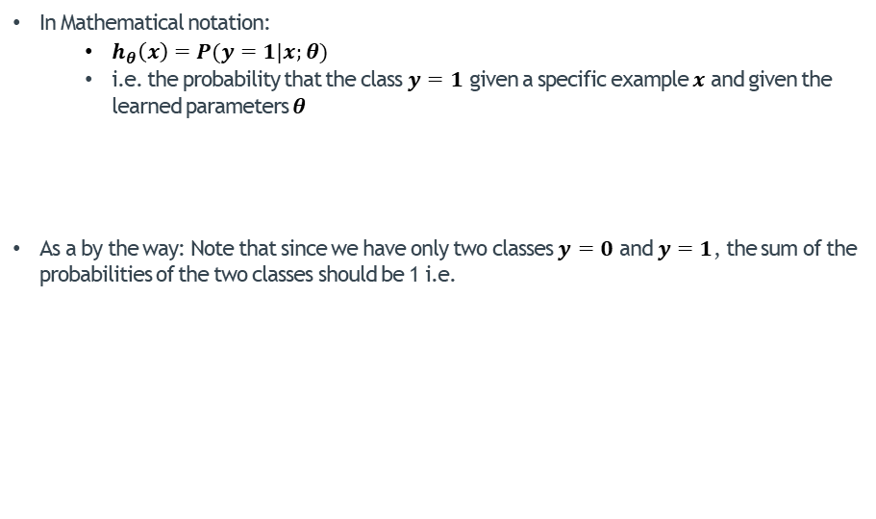



Model Representation – Deciphering $h_{θ}$
In Mathematical notation:
$h_{θ}\left(x\right)=P(y=1|x;θ)$
i.e. the probability that the class $y=1$ given a specific example $x$ and given the learned parameters $θ$
As a by the way: Note that since we have only two classes $y=0$ and $y=1$, the sum of the probabilities of the two classes should be 1 i.e.
Classification With Logistic Regression
$$P\left(y=1|x;θ\right)+P\left(y=0 | x;θ\right)=1$$
$$P\left(y=0 | x;θ\right)=1 −P\left(y=1|x;θ\right)$$
$$P\left(y=0 | x;θ\right)=1 −h_{θ}\left(x\right)$$

Slide 19
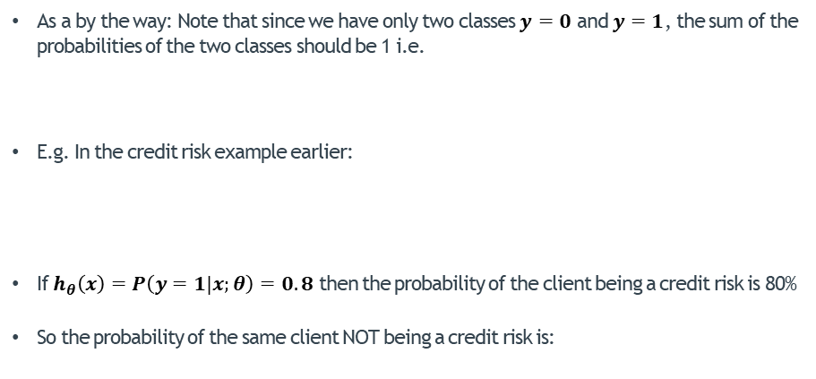



Model Representation – Deciphering $h_{θ}$
As a by the way: Note that since we have only two classes $y=0$ and $y=1$, the sum of the probabilities of the two classes should be 1 i.e.
E.g. In the credit risk example earlier:
If $h_{θ}\left(x\right)=P\left(y=1|x;θ\right)=0.8$ then the probability of the client being a credit risk is 80%
So the probability of the same client NOT being a credit risk is:
$$P\left(y=0 | x;θ\right)=1 −h_{θ}\left(x\right)$$
Classification With Logistic Regression
Given an arbitrary $x=\left[\begin{matrix}x_{0}= 1 \\ x_{1}=\text{Amount} \text{of} \text{debt}\end{matrix}\right]$
$P\left(y=0 | x;θ\right)=1−0.8=0.2$ i.e. 20%

Slide 20
Classification With Logistic Regression
Obtaining the Decision Boundary
Classification With Logistic Regression
Model Representation
Obtaining the Decision Boundary
Cost Function
Cost Function Minimization For Classification
Multi-Class Classification
Model Evaluation For Classification
Accuracy
Precision and Recall
F1 score

Slide 21


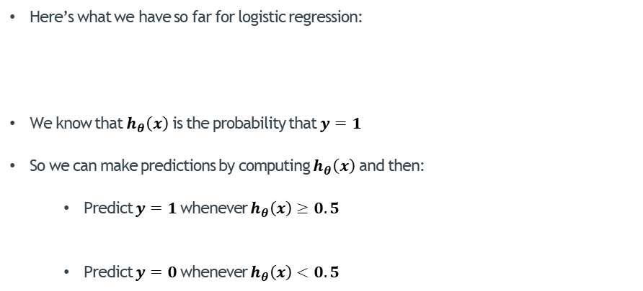


Obtaining the Decision Boundary
Here’s what we have so far for logistic regression:
We know that $h_{θ}\left(x\right)$ is the probability that $y=1$
So we can make predictions by computing $h_{θ}\left(x\right)$ and then:
Predict $y=1$whenever $h_{θ}\left(x\right)≥0.5$
Predict $y=0$whenever $h_{θ}\left(x\right)<0.5$
1
$$g\left(z\right)$$
$$g\left(z\right)=\frac{1}{1+e^{−z}}$$
$$h_{θ}\left(x\right)=g( {θ }^{T}x )$$
0.5
Classification With Logistic Regression
$$z$$

Slide 22

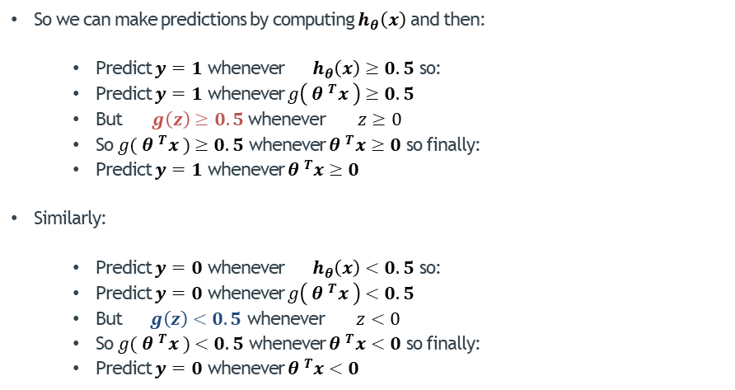



Obtaining the Decision Boundary
1
So we can make predictions by computing $h_{θ}\left(x\right)$ and then:
Predict $y=1$ whenever ${ h}_{θ}\left(x\right)≥0.5$ so:
Predict $y=1$ whenever $g\left( {θ }^{T}x \right)$ $≥0.5$
But $g\left(z\right)$ $≥0.5$ whenever $z≥0$
So $g( {θ }^{T}x )$ $≥0.5$ whenever ${θ }^{T}x≥0$ so finally:
Predict $y=1$ whenever ${θ }^{T}x≥0$
Similarly:
Predict $y=0$ whenever ${ h}_{θ}\left(x\right)<0.5$ so:
Predict $y=0$ whenever $g\left( {θ }^{T}x \right)$ $<0.5$
But $g\left(z\right)$ $<0.5$ whenever $z<0$
So $g( {θ }^{T}x )$ $<0.5$ whenever ${θ }^{T}x<0$ so finally:
Predict $y=0$ whenever ${θ }^{T}x<0$
$$g\left(z\right)$$
0.5
$$z<0$$
$$z≥0$$
$$z$$
Classification With Logistic Regression

Slide 23

Obtaining the Decision Boundary
So:
Predict $y=1$ whenever ${θ }^{T}x≥0$
Predict $y=0$ whenever ${θ }^{T}x<0$
Now let’s try to decipher:
what ${θ }^{T}x$ represents
what ${θ }^{T}x≥0$ and ${θ }^{T}x<0$ mean
Classification With Logistic Regression

Slide 24














“Decision Boundary”
Obtaining the Decision Boundary
${ x}_{1}+ x_{2}=5$
5
Amount of Defaults (R)
$$x_{2}$$
Assume we’ve obtained $θ=\left[\begin{matrix}θ_{0}=−5 \\ \begin{aligned}θ_{1}= 1 \\ θ_{2}= 1\end{aligned}\end{matrix}\right]$
So ${θ }^{T}x=θ_{0}x_{0}+{θ_{1}x}_{1}+ {θ_{2}x}_{2}=−5+{ x}_{1}+ x_{2}$
And we now have:
Predict $y=1$ whenever ${θ }^{T}x≥0$
Predict $y=0$ whenever ${θ }^{T}x<0$
4
3
Predict
$$y=0$$
${ x}_{1}+ x_{2}≥5$
2
${ x}_{1}+ x_{2}<5$
Predict
$$y=1$$
1
0
Classification With Logistic Regression
1
2
3
4
5
Amount of Debt (R)${ x}_{1}$
$−5+{ x}_{1}+ x_{2}≥0$
The “decision boundary” is given by:
${θ }^{T}x=0$ which is $−5+{ x}_{1}+ x_{2}=0$
Note that the decision boundary is defined by parameters $θ$ only
${ x}_{1}+ x_{2}≥5$
${ x}_{1}+ x_{2}=5$
$−5+{ x}_{1}+ x_{2}<0$
${ x}_{1}+ x_{2}<5$

Slide 25
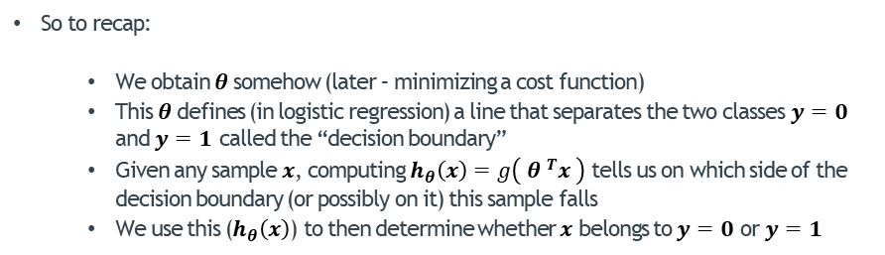
Obtaining the Decision Boundary
So to recap:
We obtain $θ$somehow (later – minimizing a cost function)
This $θ$defines (in logistic regression) a line that separates the two classes $y=0$ and $y=1$ called the “decision boundary”
Given any sample $x$, computing $h_{θ}\left(x\right)=g\left( {θ }^{T}x \right)$ tells us on which side of the decision boundary (or possibly on it) this sample falls
We use this ($h_{θ}\left(x\right)$) to then determine whether $x$ belongs to $y=0$ or $y=1$
Classification With Logistic Regression

Slide 26
Non-Linear Decision Boundaries
In Linear Regression we were able to add non-linear features in order to FIT non-linear data more tightly:
Combinations of features
Higher-order features
In Logistic Regression, we can add non-linear features in order to SEPARATE non-linear data (of different classes) more effectively:
Technique is exactly the same
The goal is different: to separate data classes
The hypothesis is different to that of Linear Regression
Classification With Logistic Regression

Slide 27















“Decision Boundary”
$$x_{2}$$
Non-Linear Decision Boundaries
$x_{1}^{2}+x_{2}^{2}≥2^{2}$
$$x_{1}^{2}+x_{2}^{2}=2^{2}$$
2
Predict
$$y=1$$
$h_{θ}\left(x\right)=g(θ_{0}x_{0}+{θ_{1}x}_{1}+ {θ_{2}x}_{2}+θ_{3}x_{1}^{2}+θ_{4}x_{2}^{2})$
Assume we’ve obtained $θ=\left[\begin{matrix}θ_{0}=−4 \\ \begin{aligned}θ_{1}= 0 \\ θ_{2}= 0 \\ θ_{3}= 1 \\ θ_{4}= 1\end{aligned}\end{matrix}\right]$
Then:
So the decision boundary is ${θ }^{T}x=0$
$$x_{1}^{2}+x_{2}^{2}<2^{2}$$
Predict
$$y=0$$
-2
2
$$x_{1}$$
$y=1$
$y=0$
-2
Classification With Logistic Regression
Predict $y=1$ whenever ${θ }^{T}x≥0$
Predict $y=0$ whenever ${θ }^{T}x<0$
$${θ }^{T}x=−4∙1+0∙x_{1}+0∙x_{2}+1∙x_{1}^{2}+1∙x_{2}^{2}$$
$$x_{1}^{2}+x_{2}^{2}≥2^{2}$$
$${θ }^{T}x=−4+x_{1}^{2}+x_{2}^{2}$$
$$x_{1}^{2}+x_{2}^{2}<2^{2}$$
$$−4+x_{1}^{2}+x_{2}^{2}=0$$
$$x_{1}^{2}+x_{2}^{2}=2^{2}$$

Slide 28




Non-Linear Decision Boundaries
In Linear Regression, we were able to get virtually any complex non-linear fit-line to tightly FIT even the most complex data
In Logistic Regression, using the same technique we can get virtually any kind of complex non-linear decision boundary by adding non-linear features to SEPARATE the data
$$x_{2}$$
$$x_{2}$$
Classification With Logistic Regression
$$x_{1}$$
$y=1$
$y=0$
$$x_{1}$$

Slide 29
Classification With Logistic Regression
Cost Function
Classification With Logistic Regression
Model Representation
Obtaining the Decision Boundary
Cost Function
Cost Function Minimization For Classification
Multi-Class Classification
Model Evaluation For Classification
Accuracy
Precision and Recall
F1 score

Slide 30
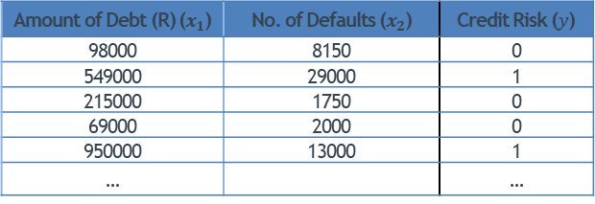





Cost Function – Can We Use $J\left(θ\right)$ Of Linear Regression?
We now have a (proven) valid hypothesis that can represent the separation of data based on two labels
Now given a data set $\left\{\left(x^{\left(1\right)},y^{\left(1\right)}\right),\left(x^{\left(2\right)},y^{\left(2\right)}\right),…,\left(x^{\left(m\right)},y^{\left(m\right)}\right)\right\}$
We need to determine parameters $θ$ of the boundary line that most effectively separates $y=0$and $y=1$
We need a cost function $J\left(θ\right)$ that we can minimize
$$h_{θ}\left(x\right)=\frac{1}{1+e^{−{θ }^{T}x}}$$
= 1
$$x^{(i)}=\left[\begin{matrix}x_{0}^{(i)} \\ x_{1}^{(i)} \\ … \\ x_{n}^{(i)}\end{matrix}\right]$$
Classification With Logistic Regression
$$y^{(i)}ε \left\{0,1\right\}$$
Amount of Debt (R) ($x_{1}$) | No. of Defaults ($x_{2}$) | Credit Risk ($y$)
98000 | 8150 | 0
549000 | 29000 | 1
215000 | 1750 | 0
69000 | 2000 | 0
950000 | 13000 | 1
… |  | …
$$θ=\left[\begin{matrix}θ_{0} \\ θ_{1} \\ \begin{aligned}. \\ .\end{aligned} \\ θ_{n}\end{matrix}\right]$$
Training set of credit riskiness

Slide 31
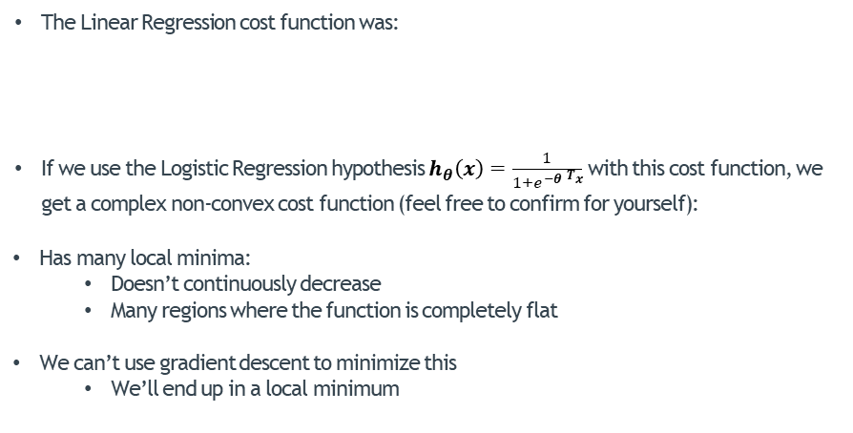
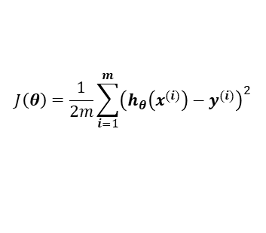
Cost Function – Can We Use $J\left(θ\right)$ Of Linear Regression?
The Linear Regression cost function was:
If we use the Logistic Regression hypothesis $h_{θ}\left(x\right)=\frac{1}{1+e^{−{θ }^{T}x}}$ with this cost function, we get a complex non-convex cost function (feel free to confirm for yourself):
Has many local minima:
Doesn’t continuously decrease
Many regions where the function is completely flat
We can’t use gradient descent to minimize this
We’ll end up in a local minimum
$$J\left(θ\right)=\frac{1}{2m}\sum_{i=1}^{m}{{\left(h_{θ}\left(x^{(i)}\right)−y^{(i)}\right)}^{2}}$$
Classification With Logistic Regression

Slide 32
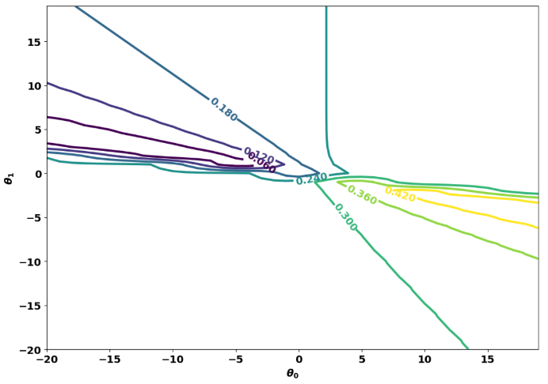
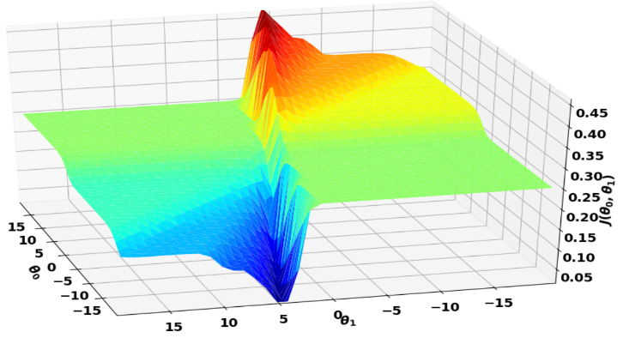
Cost Function – Can We Use $J\left(θ\right)$ Of Linear Regression?
E.g. For the Credit-Riskiness data set, using the least-squares cost function gives:
Classification With Logistic Regression

Slide 33
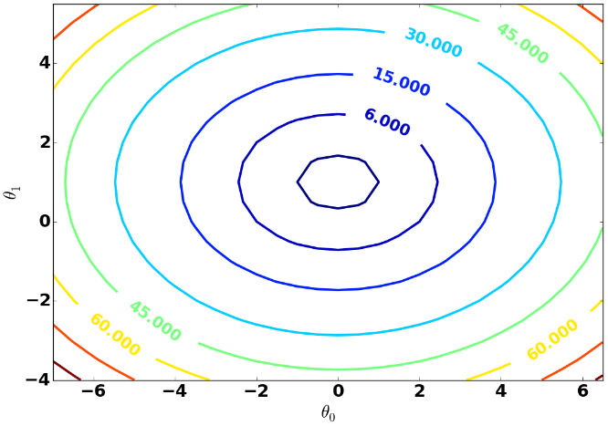
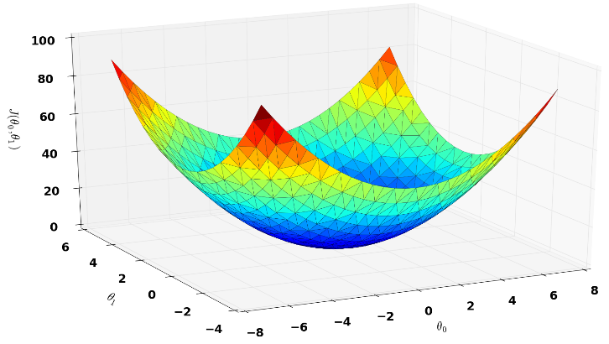
Cost Function
We need a new/different cost function for Logistic Regression that will be convex (bowl-shaped) so we can minimize it
Classification With Logistic Regression

Slide 34
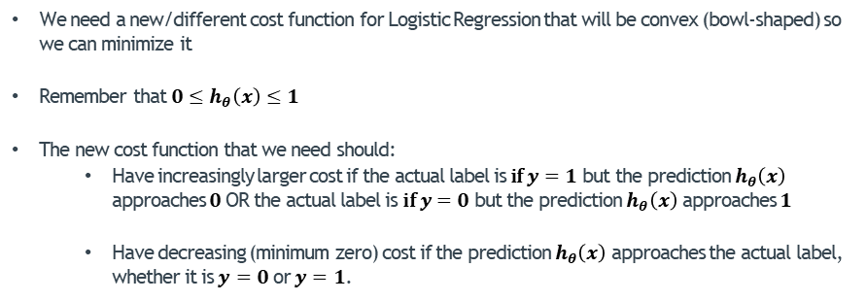
Cost Function
We need a new/different cost function for Logistic Regression that will be convex (bowl-shaped) so we can minimize it
Remember that $0≤h_{θ}\left(x\right)≤1$
The new cost function that we need should:
Have increasingly larger cost if the actual label is $\text{if} y=1$ but the prediction $h_{θ}\left(x\right)$ approaches $0$OR the actual label is $\text{if} y=0$ but the prediction $h_{θ}\left(x\right)$ approaches $1$
Have decreasing (minimum zero) cost if the prediction $h_{θ}\left(x\right)$ approaches the actual label, whether it is $y=0$ or $y=1$.
Classification With Logistic Regression

Slide 35



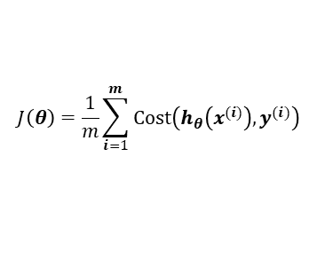


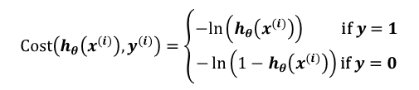

Cost Function
The following cost function has a convex shape with classification data:
$$\text{Cost}\left(h_{θ}\left(x^{(i)}\right),y^{(i)}\right)=\left\{\begin{aligned}−ln\left(h_{θ}\left(x^{(i)}\right)\right) \text{if} y=1 \\ −\ln\left(1−h_{θ}\left(x^{(i)}\right)\right)\text{if} y=0\end{aligned}\right.$$
$$J\left(θ\right)=\frac{1}{m}\sum_{i=1}^{m}{\text{Cost}\left(h_{θ}\left(x^{(i)}\right),y^{(i)}\right)}$$
Classification With Logistic Regression
$$\text{if} y=1$$
$$−ln\left(h_{θ}\left(x\right)\right)$$
$$−ln(z)$$
0
1
$$z$$
0
$$h_{θ}\left(x\right)$$
1
Range of $h_{θ}\left(x^{(i)}\right)$

Slide 36





Cost Function
The following cost function has a convex shape with classification data:
$$\text{Cost}\left(h_{θ}\left(x^{(i)}\right),y^{(i)}\right)=\left\{\begin{aligned}−ln\left(h_{θ}\left(x^{(i)}\right)\right) \text{if} y=1 \\ −\ln\left(1−h_{θ}\left(x^{(i)}\right)\right)\text{if} y=0\end{aligned}\right.$$
$$J\left(θ\right)=\frac{1}{m}\sum_{i=1}^{m}{\text{Cost}\left(h_{θ}\left(x^{(i)}\right),y^{(i)}\right)}$$
Classification With Logistic Regression
$$\text{if} y=0$$
$$−ln\left(1−h_{θ}\left(x\right)\right)$$
$$−ln(1−z)$$
0
1
$$z$$
0
$$h_{θ}\left(x\right)$$
1
Range of $h_{θ}\left(1−x^{(i)}\right)$

Slide 37






Cost Function
The following cost function has a convex shape with classification data:
$$\text{Cost}\left(h_{θ}\left(x^{(i)}\right),y^{(i)}\right)=\left\{\begin{aligned}−ln\left(h_{θ}\left(x^{(i)}\right)\right) \text{if} y=1 \\ −\ln\left(1−h_{θ}\left(x^{(i)}\right)\right)\text{if} y=0\end{aligned}\right.$$
$$J\left(θ\right)=\frac{1}{m}\sum_{i=1}^{m}{\text{Cost}\left(h_{θ}\left(x^{(i)}\right),y^{(i)}\right)}$$
Classification With Logistic Regression
$$\text{if} y=1$$
$$\text{if} y=0$$
$$−ln\left(1−h_{θ}\left(x\right)\right)$$
$$−ln\left(h_{θ}\left(x\right)\right)$$
0
$$h_{θ}\left(x\right)$$
1
0
$$h_{θ}\left(x\right)$$
1

Slide 38

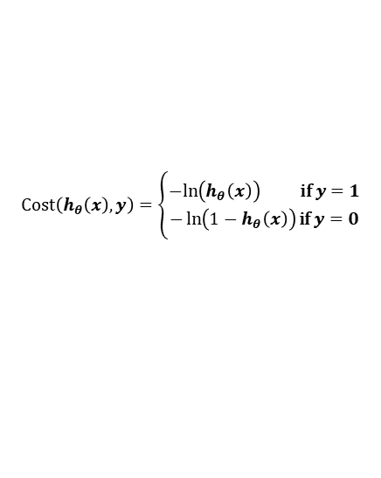

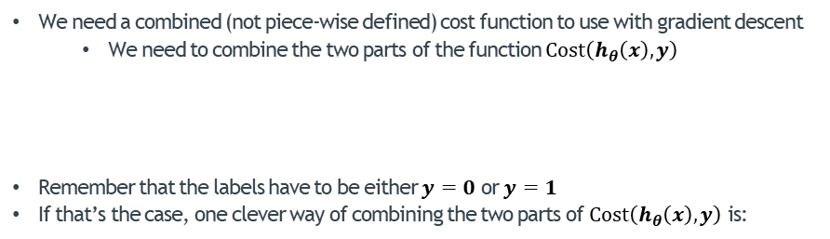

Cost Function
We need a combined (not piece-wise defined) cost function to use with gradient descent
We need to combine the two parts of the function $\text{Cost}\left(h_{θ}\left(x\right),y\right)$
Remember that the labels have to be either $y=0$ or $y=1$
If that’s the case, one clever way of combining the two parts of $\text{Cost}\left(h_{θ}\left(x\right),y\right)$ is:
$$\text{Cost}\left(h_{θ}\left(x\right),y\right)=\left\{\begin{aligned}−ln\left(h_{θ}\left(x\right)\right) \text{if} y=1 \\ −\ln\left(1−h_{θ}\left(x\right)\right)\text{if} y=0\end{aligned}\right.$$
Classification With Logistic Regression
$$\text{Cost}\left(h_{θ}\left(x\right),y\right)=−y ln\left(h_{θ}\left(x\right)\right)−(1−y)\ln\left(1−h_{θ}\left(x\right)\right)$$
$$\text{if} y=1$$
$$\text{Cost}\left(h_{θ}\left(x\right),y\right)=−1∙ ln\left(h_{θ}\left(x\right)\right)−(1−1)\ln\left(1−h_{θ}\left(x\right)\right)$$
$$=−1∙ ln\left(h_{θ}\left(x\right)\right)−(0)∙\ln\left(1−h_{θ}\left(x\right)\right)$$
$$=− ln\left(h_{θ}\left(x\right)\right)$$

Slide 39


Cost Function
We need a combined (not piece-wise defined) cost function to use with gradient descent
We need to combine the two parts of the function $\text{Cost}\left(h_{θ}\left(x\right),y\right)$
Remember that the labels have to be either $y=0$ or $y=1$
If that’s the case, one clever way of combining the two parts of $\text{Cost}\left(h_{θ}\left(x\right),y\right)$ is:
$$\text{Cost}\left(h_{θ}\left(x\right),y\right)=\left\{\begin{aligned}−ln\left(h_{θ}\left(x\right)\right) \text{if} y=1 \\ −\ln\left(1−h_{θ}\left(x\right)\right)\text{if} y=0\end{aligned}\right.$$
Classification With Logistic Regression
$$\text{Cost}\left(h_{θ}\left(x\right),y\right)=−y ln\left(h_{θ}\left(x\right)\right)−(1−y)\ln\left(1−h_{θ}\left(x\right)\right)$$
$$\text{if} y=0$$
$$\text{Cost}\left(h_{θ}\left(x\right),y\right)=−0∙ ln\left(h_{θ}\left(x\right)\right)−(1−0)\ln\left(1−h_{θ}\left(x\right)\right)$$
$$=−0∙ ln\left(h_{θ}\left(x\right)\right)−(1)∙\ln\left(1−h_{θ}\left(x\right)\right)$$
$$=− ln\left(1−h_{θ}\left(x\right)\right)$$

Slide 40
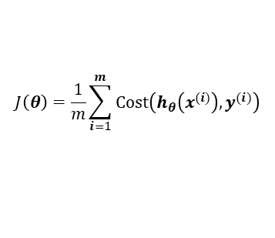

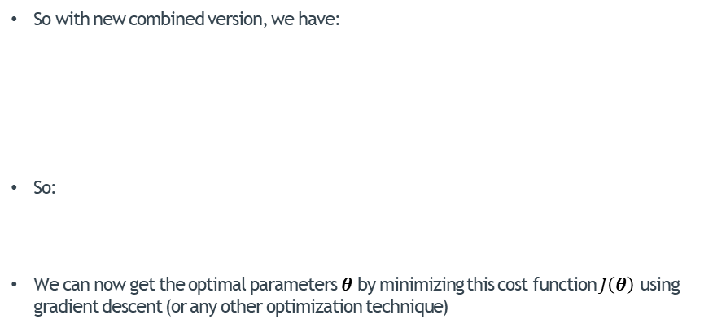

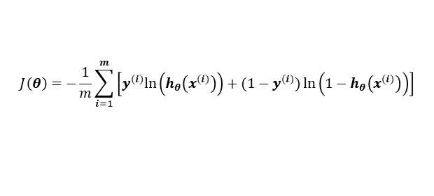
Cost Function
$$J\left(θ\right)=\frac{1}{m}\sum_{i=1}^{m}{\text{Cost}\left(h_{θ}\left(x^{(i)}\right),y^{(i)}\right)}$$
So with new combined version, we have:
So:
We can now get the optimal parameters $θ$ by minimizing this cost function $J\left(θ\right)$ using gradient descent (or any other optimization technique)
$$\text{Cost}\left(h_{θ}\left(x^{(i)}\right),y^{(i)}\right)=−y^{(i)}ln\left(h_{θ}\left(x^{(i)}\right)\right)−(1−y^{(i)})\ln\left(1−h_{θ}\left(x^{(i)}\right)\right)$$
$$=−\left[y^{(i)}ln\left(h_{θ}\left(x^{(i)}\right)\right)+(1−y^{(i)})\ln\left(1−h_{θ}\left(x^{(i)}\right)\right)\right]$$
Classification With Logistic Regression
$$J\left(θ\right)=−\frac{1}{m}\sum_{i=1}^{m}{\left[y^{(i)}ln\left(h_{θ}\left(x^{(i)}\right)\right)+(1−y^{(i)})\ln\left(1−h_{θ}\left(x^{(i)}\right)\right)\right]}$$
$$\underset{θ}{minimize}{J\left(θ\right)}$$

Slide 41

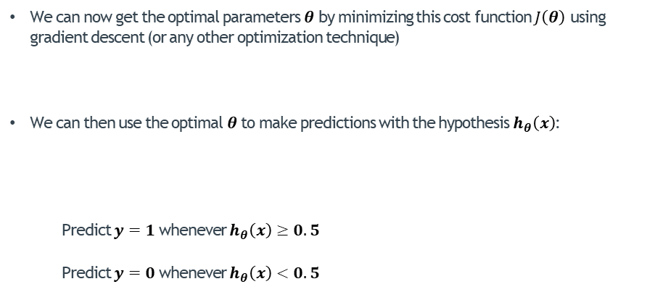

Cost Function
We can now get the optimal parameters $θ$ by minimizing this cost function $J\left(θ\right)$ using gradient descent (or any other optimization technique)
We can then use the optimal $θ$ to make predictions with the hypothesis $h_{θ}\left(x\right)$:
Predict $y=1$whenever $h_{θ}\left(x\right)≥0.5$
Predict $y=0$whenever $h_{θ}\left(x\right)<0.5$
$$\underset{θ}{minimize}{J\left(θ\right)}$$
Classification With Logistic Regression
$$h_{θ}\left(x\right)=\frac{1}{1+e^{−{θ }^{T}x}}$$

Slide 42
Classification With Logistic Regression
Cost Function Minimization For Classification
Classification With Logistic Regression
Model Representation
Obtaining the Decision Boundary
Cost Function
Cost Function Minimization For Classification
Multi-Class Classification
Model Evaluation For Classification
Accuracy
Precision and Recall
F1 score

Slide 43

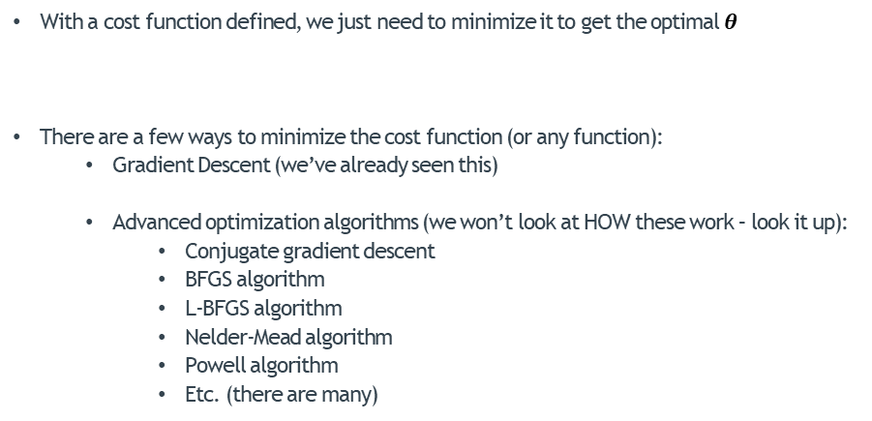
Cost Function Minimization For Classification
With a cost function defined, we just need to minimize it to get the optimal $θ$
There are a few ways to minimize the cost function (or any function):
Gradient Descent (we’ve already seen this)
Advanced optimization algorithms (we won’t look at HOW these work – look it up):
Conjugate gradient descent
BFGS algorithm
L-BFGS algorithm
Nelder-Mead algorithm
Powell algorithm
Etc. (there are many)
$$\underset{θ}{minimize}{J\left(θ\right)}$$
Classification With Logistic Regression

Slide 44



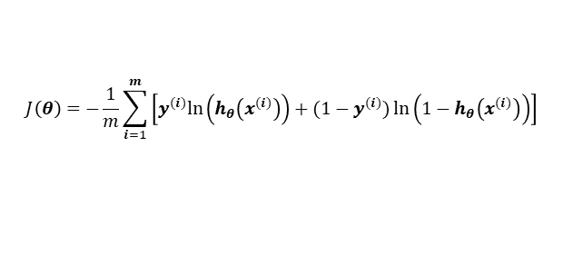
Gradient Descent For Classification
Generic gradient descent update equation (as seen before):
The hypothesis and cost function are different to that of Linear Regression:
Cost function:
Repeat until convergence:
Update all $θ_{j}$ simultaneously:
?
$$θ_{j}← θ_{j}−α \frac{∂}{∂θ_{j}}J\left(θ\right)$$
Classification With Logistic Regression
$$h_{θ}\left(x\right)=\frac{1}{1+e^{−{θ }^{T}x}}$$
$$J\left(θ\right)=−\frac{1}{m}\sum_{i=1}^{m}{\left[y^{(i)}ln\left(h_{θ}\left(x^{(i)}\right)\right)+(1−y^{(i)})\ln\left(1−h_{θ}\left(x^{(i)}\right)\right)\right]}$$

Slide 45

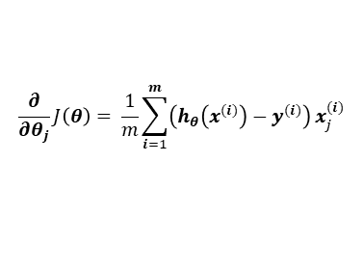
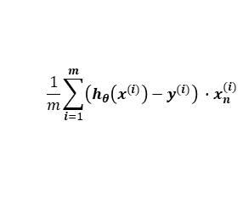


Gradient Descent for Classification
For any parameter $θ_{j}$, the gradient is given by:
$$\frac{∂}{∂θ_{j}}J\left(θ\right)= \frac{1}{m}\sum_{i=1}^{m}{\left(h_{θ}\left(x^{(i)}\right)−y^{(i)}\right)}x_{j}^{(i)}$$
Repeat until convergence:
Update all $θ$ simultaneously:
$θ_{0}← θ_{0}− α$
$θ_{1}← θ_{1}− α$
$θ_{n}← θ_{n}− α$
Algorithm appears to be identical to gradient descent with Linear Regression
It is NOT! The hypothesis here is that of logistic regression
The tuning of the learning rate follows a similar technique
Feature scaling should be applied in the same way as explained before to achieve faster convergence
Shouldn’t use a for loop: Vectorize the approach
Classification With Logistic Regression
$$\frac{1}{m}\sum_{i=1}^{m}{\left(h_{θ}\left(x^{(i)}\right)−y^{(i)}\right)∙x_{0}^{(i)}}$$
$$\frac{1}{m}\sum_{i=1}^{m}{\left(h_{θ}\left(x^{(i)}\right)−y^{(i)}\right)} ∙x_{1}^{(i)}$$
…
$$\frac{1}{m}\sum_{i=1}^{m}{\left(h_{θ}\left(x^{(i)}\right)−y^{(i)}\right)} ∙x_{n}^{(i)}$$

Slide 46
Advanced Optimization Algorithms For Classification
Advanced optimization algorithms (we won’t look at HOW these work – look it up):
Conjugate gradient descent
BFGS algorithm
L-BFGS algorithm
Nelder-Mead algorithm
Powell algorithm
Etc. (there are many)
These algorithms take in the definition of the cost function and possibly the gradient values
They minimize the function using advanced techniques
No need to worry about learning rate
Work much faster than gradient descent
Implemented in SciPy
Classification With Logistic Regression

Slide 47



Advanced Optimization Algorithms For Classification
Implemented in SciPy’s optimize library:
from scipy.optimize import minimize
theta = np.zeros(X.shape[1]) #Initialize all thetas to zeros
result = minimize(costFunc, theta, args=(X,y), method=‘TNC', jac=gradientFunc, options={'maxiter' : 400, 'disp': True})
print(result.x)
costFunc is a function that returns the cost as per:
gradientFunc is a function that returns a list/vector of the gradients of all the $θ_{j}$ as per:
Classification With Logistic Regression
$$J\left(θ\right)=−\frac{1}{m}\sum_{i=1}^{m}{\left[y^{(i)}ln\left(h_{θ}\left(x^{(i)}\right)\right)+(1−y^{(i)})\ln\left(1−h_{θ}\left(x^{(i)}\right)\right)\right]}$$
$$\frac{∂}{∂θ_{j}}J\left(θ\right)= \frac{1}{m}\sum_{i=1}^{m}{\left(h_{θ}\left(x^{(i)}\right)−y^{(i)}\right)}x_{j}^{(i)}$$

Slide 48

Advanced Optimization Algorithms For Classification
Implemented in SciPy’s optimize library:
from scipy.optimize import minimize
theta = np.zeros(X.shape[1]) #Initialize all thetas to zeros
result = minimize(costFunc, theta, args=(X,y), method=‘TNC', jac=gradientFunc, options={'maxiter' : 400, 'disp': True})
print(result.x)
result.x will contain the optimal $θ$ values
Note that X must contain an extra column of zeros representing feature $x_{0}$
Predictions can then be made by applying $h_{θ}\left(x\right)=g(θ^{T}x)$
Classification With Logistic Regression

Slide 49

Advanced Optimization Algorithms For Classification
Implemented in sklearn specifically for Logistic Regression:
from sklearn.linear_model import LogisticRegression
clf = LogisticRegression(random_state=0, solver='lbfgs', multi_class='auto')
clf.fit(X, y)
Note that X should NOT contain the extra column of 1s for feature $x_{0}$.
Predictions can then be made seamlessly:
predictionvalue = clf.predict(x_new)
print(predictionvalue)
Classification With Logistic Regression

Slide 50
Classification With Logistic Regression
Multi-Class Classification
Classification With Logistic Regression
Model Representation
Obtaining the Decision Boundary
Cost Function
Cost Function Minimization For Classification
Multi-Class Classification
Model Evaluation For Classification
Accuracy
Precision and Recall
F1 score

Slide 51







Multi-Class Classification
Two broad types of classification
Binary classification; $y ε \left\{0,1\right\}$
Two classes E.g.
Credit-riskiness
Not Risky ̶ Risky
Fraud detection
Non-fraud ̶ Fraud
Sentiment detection / analysis
Negative ̶ Positive
Facial expression recognition
Emotive ̶ Non-Emotive
Multi-class classification; $y ε \left\{0,1,2…,k\right\}$
Three or more classes E.g.
Credit-riskiness level
0 Risk ̶ 1 Risk ̶ 2 Risk ̶ 3 Risk
Sentiment detection / analysis
Neutral ̶ Positive ̶ Negative
Facial expression recognition
Neutral ̶ Positive ̶ Negative
Neutral ̶ Happy ̶ Sad ̶ Surprise ̶ Disgust ̶ Angry
Classification With Logistic Regression
$$y ε \left\{0,1,2,3 \right\}$$
$$y ε \left\{0,1,2 \right\}$$
$$y ε \left\{0,1,2 \right\}$$
$$y ε \left\{0,1,2,3,4,5\right\}$$
$$y ε \left\{0,1,2\right\}$$

Slide 52










Multi-Class Classification
Two broad types of classification
Binary classification; $y ε \left\{0,1\right\}$
Multi-class classification; $y ε \left\{1,2,3\right\}$
Classification With Logistic Regression
$y=3$
$$x_{2}$$
$y=1$
$$x_{2}$$
$y=0$
$y=2$
$y=1$
$${ x}_{1}$$
$${ x}_{1}$$
$$y ε \left\{0,1,2\right\}$$

Slide 53
Multi-Class Classification
Two main methods of achieving multi-class classification:
One-vs-Rest
One-vs-One
Classification With Logistic Regression

Slide 54






Multi-Class Classification – One-Vs-Rest
One-vs-Rest:
Decompose the $K$ classes into $K$ binary classification problems
Create $K$ separate classifiers $h_{θ}^{\left(i\right)}\left(x\right)$ where $i=1,2…,K$.
In each classifier, set one of the $K$ classes as $y=1$ and combine all other classes into a single class $y=0$
E.g. for a 3-class problem:
Classification With Logistic Regression
$$x_{2}$$
$y=3$
$y=2$
$y=1$
$${ x}_{1}$$

Slide 55







Multi-Class Classification – One-Vs-Rest
One-vs-Rest:
Decompose the $K$ classes into $K$ binary classification problems
Create $K$ separate classifiers $h_{θ}^{\left(i\right)}\left(x\right)$ where $i=1,2…,K$.
In each classifier, set one of the $K$ classes as $y=1$ and combine all other classes into a single class $y=0$
E.g. for a 3-class problem:
Classification With Logistic Regression
$$h_{θ}^{\left(1\right)}\left(x\right)$$
$$h_{θ}^{\left(2\right)}\left(x\right)$$
$$h_{θ}^{\left(3\right)}\left(x\right)$$
$$x_{2}$$
$$x_{2}$$
$$x_{2}$$
$${ x}_{1}$$
$${ x}_{1}$$
$${ x}_{1}$$
$y=0$
$y=0$
$y=0$
$y=1$
$y=1$
$y=1$

Slide 56










Multi-Class Classification – One-Vs-Rest
E.g. With the 3-class problem: assume we have a new $x$ that actually belongs to class i.e. $y=3$
Pass $x$ to $h_{θ}^{\left(1\right)}\left(x\right)$ , $h_{θ}^{\left(2\right)}\left(x\right)$ and $h_{θ}^{\left(3\right)}\left(x\right)$
Therefore the predicted class is taken to be which is $y=3$ in the original data set
$$h_{θ}^{\left(1\right)}\left(x\right)$$
$$h_{θ}^{\left(2\right)}\left(x\right)$$
$$h_{θ}^{\left(3\right)}\left(x\right)$$
$$x_{2}$$
$$x_{2}$$
Classification With Logistic Regression
$${ x}_{1}$$
$${ x}_{1}$$
$${ x}_{1}$$
$y=0$
$y=0$
$y=0$
$y=1$
$y=1$
$y=1$
$$h_{θ}^{\left(1\right)}\left(x\right)=P\left(y=1 | x;θ\right)=0.01$$
$$h_{θ}^{\left(2\right)}\left(x\right)=P\left(y=1 | x;θ\right)=0.15$$
$$h_{θ}^{\left(3\right)}\left(x\right)=P\left(y=1 | x;θ\right)=0.97$$

Slide 57



Multi-Class Classification – One-Vs-Rest
One-vs-Rest:
Decompose the $K$ classes into $K$ binary classification problems
Create $K$ separate classifiers $h_{θ}^{\left(i\right)}\left(x\right)$ where $i=1,2…,K$.
In each classifier, set one of the $K$ classes as $y=1$ and combine all other classes into a single class $y=0$
Remember that the prediction of $h_{θ}^{\left(i\right)}\left(x\right)$ is actually a probability; in this case, the probability that $y=i$:
Then, given an unknown sample $x$, pass it to all $h_{θ}^{\left(i\right)}\left(x\right)$ classifiers: classifier $i$ with the highest probability means that $x$ most likely belongs to class $i$
Mathematically:
Classification With Logistic Regression
$$h_{θ}^{\left(i\right)}\left(x\right)=P(y=1|x;θ)$$
$$\max_{i} h_{θ}^{\left(i\right)}\left(x\right)$$

Slide 58
Multi-Class Classification – One-Vs-One
E.g. With the 3-class problem:
$$x_{2}$$
$y=3$
$y=2$
$y=1$
Classification With Logistic Regression
$${ x}_{1}$$

Slide 59
















Multi-Class Classification – One-Vs-One
E.g. With the 3-class problem: assume we have a new $x$ that actually belongs to class i.e. $y=3$
$$h_{θ}^{\left(1,2\right)}\left(x\right)$$
$$h_{θ}^{\left(1,3\right)}\left(x\right)$$
$$h_{θ}^{\left(2,3\right)}\left(x\right)$$
$y=0$
$$x_{2}$$
$y=0$
$$x_{2}$$
$y=0$
$y=1$
$y=1$
$y=1$
Classification With Logistic Regression
$${ x}_{1}$$
$${ x}_{1}$$
$${ x}_{1}$$
$h_{θ}^{\left(i\right)}\left(x\right)=0.48$ so:
$h_{θ}^{\left(i\right)}\left(x\right)=0.97$ so:
$h_{θ}^{\left(i\right)}\left(x\right)=0.99$ so:
$$P\left(y=1 | x;θ\right)=0.48$$
$$P\left(y=1 | x;θ\right)=0.97$$
$$P\left(y=1 | x;θ\right)=0.99$$
$$P\left(y=0 | x;θ\right)=0.52$$
$$P\left(y=0 | x;θ\right)=0.03$$
$$P\left(y=0 | x;θ\right)=0.01$$
Totals:
$$=0.48+0.01$$
$$=0.49$$
$$=0.52+0.03$$
$$=0.55$$
$$=0.97+0.99$$
$$=1. 96$$

Slide 60




Multi-Class Classification – One-Vs-One
E.g. With the 3-class problem: assume we have a new $x$ that actually belongs to class i.e. $y=3$
Therefore the predicted class is taken to be which is $y=3$ in the original data set
$$h_{θ}^{\left(1,2\right)}\left(x\right)$$
$$h_{θ}^{\left(1,3\right)}\left(x\right)$$
$$h_{θ}^{\left(2,3\right)}\left(x\right)$$
$y=0$
$$x_{2}$$
$y=0$
$$x_{2}$$
$y=0$
$y=1$
$y=1$
$y=1$
Classification With Logistic Regression
$${ x}_{1}$$
$${ x}_{1}$$
$${ x}_{1}$$
$h_{θ}^{\left(i\right)}\left(x\right)=0.48$ so:
$h_{θ}^{\left(i\right)}\left(x\right)=0.97$ so:
$h_{θ}^{\left(i\right)}\left(x\right)=0.99$ so:
$$P\left(y=1 | x;θ\right)=0.48$$
$$P\left(y=1 | x;θ\right)=0.97$$
$$P\left(y=1 | x;θ\right)=0.99$$
$$P\left(y=0 | x;θ\right)=0.52$$
$$P\left(y=0 | x;θ\right)=0.03$$
$$P\left(y=0 | x;θ\right)=0.01$$
Totals:
$$=0.49$$
$$=0.55$$
$$=1. 96$$

Slide 61



Multi-Class Classification – One-Vs-One
One-vs-One:
Create a series of binary classifiers $h_{θ}^{\left(i,j\right)}\left(x\right)$, which deal with only a pair of classes $i$ and $j$.
Remember that the prediction of $h_{θ}^{\left(i,j\right)}\left(x\right)$ is actually a probability; in this case, the probability that $y=i$:
But we can also infer the probability of class $y=0$:
In this technique, we keep track of the total probability of each class:
The class with the max probability wins
$$h_{θ}^{\left(i\right)}\left(x\right)=P(y=1|x;θ)$$
Classification With Logistic Regression
$$P\left(y=0 | x;θ\right)={1−h}_{θ}^{\left(i\right)}\left(x\right)$$

Slide 62

Multi-Class Classification – One-Vs-One
One-vs-One:
Number of classifiers trained:
3 classes: 3 classifiers i.e. classes 1-2, classes 1-3, classes 2-3
4 classes: 6 classifiers i.e. classes 1-2, classes 1-3, classes 1-4, classes 2-3, classes 2-4, classes 3-4
$K$classes: $\frac{1}{2}K(K−1)$
Classification With Logistic Regression

Slide 63
Multi-Class Classification
One-vs-Rest:
Computationally cheaper and simpler
Fewer classifiers are trained
Fewer classifiers are used to make predictions
More sensitive to unbalanced classes (find out why)
Can be less accurate
One-vs-One:
Computationally more expensive
Many more classifiers are trained
Many more classifiers are used to make predictions
Less sensitive to unbalanced classes (find out why)
Can be more accurate
Classification With Logistic Regression

Slide 64
Model Evaluation For Classification
Accuracy
Classification With Logistic Regression
Model Representation
Obtaining the Decision Boundary
Cost Function
Cost Function Minimization For Classification
Multi-Class Classification
Model Evaluation For Classification
Accuracy
Precision and Recall
F1 score

Slide 65

Introduction
When evaluating/comparing models, all the techniques described under Linear Regression apply i.e.
Divide up data into Train-CV-Test OR:
k-fold Cross-validation
Question: what metrics do we use for classification?
The metrics change for classification:
Accuracy
Precision
Recall
F1 score
Running example: credit-riskiness
Assume we’ve trained a model $h_{θ}\left(x^{\left(i\right)}\right)$ for credit-riskiness on the Train set $x_{\text{Train}}^{(i)}$
We need to evaluate the model on the Test set $x_{\text{T}\text{est}}^{(i)}$
Available Data
Model Evaluation For Classification
Train
CV
Test

Slide 66


Accuracy
Accuracy: the most basic metric
Apply the test set samples $x_{\text{Test}}^{(i)}$ to the trained model $h_{θ}\left(x^{\left(i\right)}\right)$ to get prediction labels for each sample
The accuracy is the proportion/percentage of test samples for which the actual label $y_{\text{Test}}^{(i)}$ matched the predicted label $h_{θ}\left(x_{\text{Test}}^{(i)}\right)$:
Model Evaluation For Classification
$$\text{Accuracy}\text{=}\frac{\text{Total} \text{Correct}}{\text{Total} \text{Test} \text{Samples}}×100$$

Slide 67
Model Evaluation For Classification
Precision and Recall
Classification With Logistic Regression
Model Representation
Obtaining the Decision Boundary
Cost Function
Cost Function Minimization For Classification
Multi-Class Classification
Model Evaluation For Classification
Accuracy
Precision and Recall
F1 score

Slide 68
Precision and Recall – The Problem
Skew classes:
A case in which one of the classes to be predicted is scarce in the data set
In such data sets, we may not have many examples of the one of the classes
E.g.
Fraud: there may be far fewer examples of fraud cases than legitimate cases
Cancer: there may be far fewer examples of cancerous cases than non-cancerous cases
In such cases, one class (usually the class we’re interested in) may only make up a small percentage of the examples e.g. only 0.5% of the examples
The classifier may become very good at detecting negative cases, but not positive cases
Using accuracy will not be a good reflection of the classifier performance
Model Evaluation For Classification

Slide 69

Precision and Recall – The Problem
Skew classes:
A case in which one of the classes to be predicted is scarce in the data set
In such data sets, we may not have many examples of the one of the classes
E.g. For the credit-riskiness data set, assume we have a test set of 1500 negative (non-risky $y=0$) examples, and only 50 positive (risky $y=1$) examples
If our classifier correctly predicts 1300 negative samples, but only 10 of the positive examples, accuracy is?
$\frac{\text{1300+10}}{\text{1500+50}}×100=84.5\%$
But is this classifier really good at predicting credit-riskiness?? (NO!)
Model Evaluation For Classification

Slide 70

Precision and Recall – The Problem
Skew classes:
A case in which one of the classes to be predicted is scarce in the data set
In such data sets, we may not have many examples of the one of the classes
E.g. For the credit-riskiness data set, assume we have a test set of 1500 negative (non-risky 𝒚=𝟎) examples, and only 50 positive (risky 𝒚=𝟏) examples
In fact, considering the skewness of the classes, we can use a dummy function to get an even better accuracy:
Using this function to “predict” will give us an accuracy of?
$\frac{\text{1500}}{\text{1500}\text{+}\text{50}}×100=96.8\%$
Accuracy is not a true reflection of underlying performance at all (in such cases)
Model Evaluation For Classification
def predict(X): return 0 #Just ignore X. Assume the class is 0

Slide 71
Precision and Recall – The Problem
We need some other way of evaluating our classifier that is not sensitive to the class distribution of examples – we’re going to work towards it
Four things that are important:
Of the cases that are actually positive (e.g. risky, fraudulent, cancerous etc.):
how many are predicted correctly by the classifier?
how many are predicted wrongly by the classifier?
Of the cases that are actually negative (e.g. reliable, not fraudulent, benign etc.):
how many are predicted correctly by the classifier?
how many are predicted wrongly by the classifier?
We don’t want someone who is risky, fraudulent, cancerous etc. to slip through the cracks
We don’t want to tell someone they are risky, fraudulent, cancerous etc. if they aren’t
Model Evaluation For Classification

Slide 72
Precision and Recall – Confusion Matrix
The four questions on the previous slide have specific “names” in ML literature:
Of the cases that are actually positive:
how many are predicted correctly by the classifier?
how many are predicted wrongly by the classifier?
Of the cases that are actually negative
how many are predicted correctly by the classifier?
how many are predicted wrongly by the classifier?
Model Evaluation For Classification
predicted
We can represent this information in a table called a “Confusion Matrix”
 | 1 | 0
1
0
1.
2.
actually
4.
3.

Slide 73
Precision and Recall – Confusion Matrix
The four questions on the previous slide have specific “names” in ML literature:
Of the cases that are actually positive:
how many are predicted correctly by the classifier? True Positives
how many are predicted wrongly by the classifier? False Negatives
Of the cases that are actually negative
how many are predicted correctly by the classifier? True Negatives
how many are predicted wrongly by the classifier? False Positives
Model Evaluation For Classification
predicted
In the label True/False Positive/Negative:
Positive/Negative refers to the prediction
True/False refers to whether the prediction was right or wrong
 | 1 | 0
1 | True Positives | False Negatives
0 | False Positives | True Negatives
actually
Notes:
The Positive or Negative here implies the PREDICTION:
-A True Positive means something that was predicted as Positive and correctly so
-A False Positive means something that was predicted as Positive and incorrectly so
-A True Negative means something that was predicted as Negative and correctly so
-A False Negative means something that was predicted as Negative and incorrectly so

Slide 74
Precision and Recall – Confusion Matrix
E.g. For credit riskiness, fill in the confusion matrix for:
50 positive examples of which 10 were correctly predicted
1500 negative examples of which 1300 were correctly predicted
TP: 10 FN: 40
FP: 200 TN: 1300
Model Evaluation For Classification
predicted
 | 1 | 0
1 | 10 | 40
0 | 200 | 1300
actually

Slide 75
Precision and Recall – Confusion Matrix
E.g. For credit riskiness, fill in the confusion matrix for:
15 positive examples of which 7 were correctly predicted
270 negative examples of which 200 were correctly predicted
TP: 7 FN: 8
FP: 70 TN: 200
Model Evaluation For Classification
predicted
 | 1 | 0
1 | 7 | 8
0 | 70 | 200
actually

Slide 76
Precision and Recall – Confusion Matrix
E.g. For cat detection, fill in the confusion matrix for:
850 positive examples of which 420 were INcorrectly predicted
650 negative examples of which 360 were INcorrectly predicted
TP: 430 FN: 420
FP: 360 TN: 290
Model Evaluation For Classification
predicted
 | 1 | 0
1 | 430 | 420
0 | 360 | 290
actually

Slide 77
Precision and Recall – Confusion Matrix
E.g. For cancer detection, fill in the confusion matrix for:
160 positive examples of which 10 were INcorrectly predicted
1750 negative examples of which 600 were correctly predicted
TP: 150 FN: 10
FP: 1150 TN: 600
Model Evaluation For Classification
predicted
 | 1 | 0
1 | 150 | 10
0 | 1150 | 600
actually

Slide 78


Precision and Recall – The Story
You’ve employed a diamond expert to help you dig for diamonds
The main question you want him to answer: where should you dig?
When he says “dig here”, do you trust him (precision)? How many of the diamonds will he find (recall)?
Model Evaluation For Classification

Slide 79

Precision and Recall – Interpretation
Perfect Case:
Whenever he says “Diamond”, it definitely is… DIG! (High Precision)
He finds ALL the diamonds! (High Recall)
Model Evaluation For Classification

Slide 80
Precision and Recall – Interpretation
Non-Ideal Case:
Whenever he says “Diamond”, it definitely is… DIG! (High Precision)
He only finds very few diamonds! Is this gonna be sustainable?? (Low Recall)
Model Evaluation For Classification

Slide 81
Precision and Recall – Interpretation
Non-Ideal Case:
When he says “Diamond”, it is unlikely that it is… dig?? Rather ask your cat… (Low Precision)
He finds many/all the diamonds! In essence, he’s just saying “DIG EVERYWHERE. You’re bound to get all the diamonds that way…” Can we really dig everywhere? (High Recall)
Model Evaluation For Classification

Slide 82

Precision
For any classifier, there are two critical questions:
Precision: How reliable / trustworthy / precise are the classifier’s predictions?
Can we trust the classifier’s predictions?
When the classifier throws an alarm (i.e. $y=1$, risky, fraudulent, cancerous) how sure can we be that it actually is? We wouldn’t want to react unnecessarily
When the classifier says all is fine (i.e. $y=0$, not risky, not fraudulent, not cancerous) how sure can we be that it actually is?
Another way of saying this: of the cases that the classifier predicts as positive, what proportion are predicted correctly?
Model Evaluation For Classification

Slide 83


Precision
For any classifier, there are two critical questions:
Precision: How reliable / trustworthy / precise are the classifier’s predictions?
Another way of saying this: of the cases that the classifier predicts as positive, what proportion are predicted correctly?
Cases predicted correctly: True Positives
Cases predicted as positive: True Positives + False Positives
(all of the cases predicted as positive)
Model Evaluation For Classification
predicted
 | 1 | 0
1 | True Positives | False Negatives
0 | False Positives | True Negatives
$$\text{Precision}\text{ = }\frac{\text{True} \text{Positives}}{ \text{Total} \text{Positive} \text{Predictions}}(×100)$$
$$=\frac{\text{True} \text{Positives}}{\text{True} \text{Positives}\text{+}\text{False} \text{Positives}}(×100)$$
actually

Slide 84

Recall
For any classifier, there are two critical questions:
Recall: How comprehensive/thorough is the classifier in finding cases that are actually positive?
How many of the actually positive cases can the classifier actually find?
How sure can we be that the classifier will find all of the positive cases?
How sure can we be that all of the positive cases (i.e. $y=1$, risky, fraudulent, cancerous) won’t just slip through undetected?
When the classifier identifies a bunch of cases as being positive, how sure can we be that these are all of them?
We wouldn’t want to miss positive cases which need to be reacted on
Another way of saying this: of the cases that are actually positive, what proportion are predicted correctly?
Model Evaluation For Classification

Slide 85


Recall
For any classifier, there are two critical questions:
Recall: How comprehensive/thorough is the classifier in finding cases that are actually positive?
Another way of saying this: of the cases that are actually positive, what proportion are predicted correctly?
Cases predicted correctly: True Positives
Cases actually positive: True Positives + False Negatives
(all of the actually positive examples)
Model Evaluation For Classification
predicted
 | 1 | 0
1 | True Positives | False Negatives
0 | False Positives | True Negatives
$$\text{Recall}\text{ = }\frac{\text{True} \text{Positives}}{ \text{Total} \text{Actual} \text{Positive} \text{Examples}}(×100)$$
$$= \frac{\text{True} \text{Positives}}{\text{True} \text{Positives}\text{+}\text{False} \text{Negatives}}(×100)$$
actually

Slide 86



Precision and Recall – The Problem (Revisited)
E.g. For the credit-riskiness data set, assume we have a test set of 1500 negative (non-risky $y=0$) examples, and only 50 positive (risky $y=1$) examples
If our classifier correctly predicts 1300 negative samples, but only 10 of the positive examples, accuracy was:
$\frac{\text{1300+10}}{\text{1500+50}}×100=84.5\%$
What about precision?
$\frac{\text{TP}}{\text{TP}\text{+}\text{FP}}$
And recall?
$\frac{\text{TP}}{\text{TP}\text{+}\text{FN}}$
Accuracy was deceiving, but not precision and recall. This classifier is awful
predicted
Model Evaluation For Classification
 | 1 | 0
1 | 10 | 40
0 | 200 | 1300
$$=\frac{\text{10}}{\text{10+200}}×100≈5\%$$
actually
$$=\frac{\text{10}}{\text{10+40}}×100=20\%$$

Slide 87



Precision and Recall – The Problem (Revisited)
E.g. For the credit-riskiness data set, assume we have a test set of 1500 negative (non-risky 𝒚=𝟎) examples, and only 50 positive (risky 𝒚=𝟏) examples
What about the dummy function?
Using this function to “predict” gave us an accuracy of:
$\frac{\text{1500}}{\text{1500}\text{+}\text{50}}×100=96.8\%$
What’s the precision of the dummy function?
$\frac{\text{TP}}{\text{TP}\text{+}\text{FP}}$
What’s the recall of the dummy function?
$\frac{\text{TP}}{\text{TP}\text{+}\text{FN}}$
Accuracy was deceiving, but not precision and recall
def predict(X): return 0 #Just ignore X. Assume the class is 0
Model Evaluation For Classification
predicted
$$=\frac{\text{0}}{\text{0}\text{+}\text{0}}×100=\left[\text{NaN}\right] \sim 0\%$$
 | 1 | 0
1 | 0 | 50
0 | 0 | 1500
actually
$$=\frac{\text{0}}{\text{0}\text{+}\text{50}}×100=0\%$$

Slide 88

Precision and Recall
E.g. For cat detection:
275 positive examples of which 200 were INcorrectly predicted
260 negative examples of which 20 were INcorrectly predicted
Accuracy:
$\frac{\text{75+240}}{\text{275+260}}×100=58.9\%$
Precision:
$\frac{\text{TP}}{\text{TP}\text{+}\text{FP}}=\frac{\text{75}}{\text{75}\text{+}\text{20}}×100=78.9\%$
Recall:
$\frac{\text{TP}}{\text{TP}\text{+}\text{FN}}=\frac{\text{75}}{\text{75}\text{+}\text{200}}×100=27.3\%$
Interpretation: (High Prec): When it says it’s a cat, very good (79%) chance it is; (Low Rec) BUT it won’t find a lot of these cats… a lot of the cats will simply go undetected (as non-cats)…
Model Evaluation For Classification
predicted
 | 1 | 0
1 | 75 | 200
0 | 20 | 240
actually

Slide 89

Precision and Recall
E.g. For cancer detection:
160 positive examples of which 10 were INcorrectly predicted
1750 negative examples of which 600 were correctly predicted
Accuracy:
$\frac{\text{150}\text{+}\text{600}}{\text{160}\text{+}\text{1750}}×100=39.2\%$
Precision:
$\frac{\text{TP}}{\text{TP}\text{+}\text{FP}}=\frac{\text{150}}{\text{15}\text{0}\text{+}\text{115}\text{0}}×100=11.5\%$
Recall:
$\frac{\text{TP}}{\text{TP}\text{+}\text{FN}}=\frac{\text{150}}{\text{150}\text{+}\text{10}}×100=93.8\%$
Interpretation: (High Recall): It’ll find almost all cancer cases and “treat” them; (Low Prec) BUT it’ll also end up telling a lot of people who aren’t cancerous that they are… and possible “treat” them too…
Model Evaluation For Classification
predicted
 | 1 | 0
1 | 150 | 10
0 | 1150 | 600
actually

Slide 90
Precision and Recall – Interpretation
Ideal Case:
High Precision – High Recall: Whenever it says it’s a positive it most likely is; and it will successfully locate (almost) all positive cases (few/none will slip through)
Non-Ideal Cases:
High Precision – Low Recall: Whenever it says it’s a positive it most likely is; BUT it will locate very few (if any) positive cases (many will slip through)
High Recall – Low Precision: It will locate (almost) all positive cases (few/none will slip through); BUT when it says it’s a positive, it will most likely not be one – we can’t trust it
Model Evaluation For Classification

Slide 91
Model Evaluation For Classification
F1 Score
Classification With Logistic Regression
Model Representation
Obtaining the Decision Boundary
Cost Function
Cost Function Minimization For Classification
Multi-Class Classification
Model Evaluation For Classification
Accuracy
Precision and Recall
F1 score

Slide 92

F1 Score – The Problem
We’ve now got two numbers (precision and recall)
They give us a very good understanding of our classifier’s performance
BUT they are still TWO numbers
We need some way of combining the two numbers into one number
E.g. For the credit-riskiness example: imagine we have three different hypotheses:
$h_{θ}\left(x\right)=g(θ_{0}x_{0}+{θ_{1}x}_{1})$
$h_{θ}\left(x\right)=g\left(θ_{0}x_{0}+{θ_{1}x}_{1}+ {θ_{2}x}_{2}\right)$
$h_{θ}\left(x\right)=g(θ_{0}x_{0}+{θ_{1}x}_{1}+ {θ_{2}x}_{2}+θ_{3}x_{1}^{2}+θ_{4}x_{2}^{2})$
Where $x_{1}$ is the No of Defaults and $x_{2}$ is the Total Debt Owed (R)
How do these hypotheses compare??
One way: compute precision and recall
Model Evaluation For Classification

Slide 93
F1 Score – The Problem
We get these results:
Which model is best? We need some way of combining the two numbers into one number
One possible way: taking the average??
Approach | Precision (%) | Recall (%)
1 | 60 | 40
2 | 12 | 98
3 | 95 | 5
Model Evaluation For Classification

Slide 94
F1 Score – The Problem
We get these results:
The average doesn’t seem to be a good indicator for performance:
All these approaches appear to be almost exactly the same considering the average whereas:
Algorithm 1 is more balanced between precision and recall
Algorithm 2 simply says “Dig everywhere”
Algorithm 3 only finds one diamond and calls it a day
Approach | Precision (%) | Recall (%) | Average (%)
1 | 60 | 40 | 50
2 | 12 | 98 | 55
3 | 95 | 5 | 50
Model Evaluation For Classification

Slide 95

F1 Score – Definition
We get these results:
The F1 score (a.k.a the “harmonic mean” of precision and recall) provides a much more balanced measure:
Approach | Precision (%) | Recall (%) | F1 Score (%)
1 | 60 | 40 | 48
2 | 12 | 98 | 21
3 | 95 | 5 | 10
Model Evaluation For Classification
$$\text{F}\text{1 }\text{Score}\text{ = }\frac{\text{2 }\text{∙}\text{Precision}\text{∙}\text{Recall}}{ \text{Precision}\text{+}\text{Recall}}$$

Slide 96
F1 Score – Characteristics
We get these results:
Does the F1 Score reflect what we see in precision and recall?
Algorithm 1 is more balanced between precision and recall
Algorithm 2 simply says “Dig everywhere”
Algorithm 3 only “finds one diamond and calls it a day”
Approach | Precision (%) | Recall (%) | F1 Score (%)
1 | 60 | 40 | 48
2 | 12 | 98 | 21
3 | 95 | 5 | 10
Model Evaluation For Classification

Slide 97
F1 Score – Interpretation
When precision is 1 or 100% AND recall is 1 or 100% → F1 Score is 1 or 100%
In order to get a perfect F1 score, BOTH the precision AND recall have to be perfect
If either precision is 0 OR recall is 0 → F1 Score is 0
If either the precision or recall suffers (regardless of whether or not the other is high), then the F1 score suffers accordingly too
There’s no cheating the F1 score: having a very high precision/recall value while the other precision/recall value is very low will clearly reflect in the F1 score
F1 score favours more balanced precision and recall scores
Model Evaluation For Classification

Slide 98

F1 Score
E.g. For cat detection:
275 positive examples of which 200 were INcorrectly predicted
260 negative examples of which 20 were INcorrectly predicted
Precision:
$\frac{\text{TP}}{\text{TP}\text{+}\text{FP}}=\frac{\text{75}}{\text{75}\text{+}\text{20}}×100=78.9\%$
Recall:
$\frac{\text{TP}}{\text{TP}\text{+}\text{FN}}=\frac{\text{75}}{\text{75}\text{+}\text{200}}×100=27.3\%$
F1 Score:
$\frac{\text{2}\text{PR}}{\text{P}\text{+}\text{R}}=\frac{\text{2 }×\text{78.9} ×\text{27.3}}{\text{78.9} \text{+} \text{27.3}}=40.6\%$
Model Evaluation For Classification
predicted
 | 1 | 0
1 | 75 | 200
0 | 20 | 240
actually

Slide 99

F1 Score
E.g. For cancer detection:
160 positive examples of which 10 were INcorrectly predicted
1750 negative examples of which 600 were correctly predicted
Precision:
$\frac{\text{TP}}{\text{TP}\text{+}\text{FP}}=\frac{\text{150}}{\text{15}\text{0+}\text{115}\text{0}}×100=11.5\%$
Recall:
$\frac{\text{TP}}{\text{TP}\text{+}\text{FN}}=\frac{\text{150}}{\text{150+10}}×100=93.8\%$
F1 Score:
$\frac{\text{2}\text{PR}}{\text{P}\text{+}\text{R}}=\frac{\text{2 }×\text{11.5} ×\text{93.8}}{\text{11.5 }\text{+}\text{ 93.8}}=20.5\%$
Model Evaluation For Classification
predicted
 | 1 | 0
1 | 150 | 10
0 | 1150 | 600
actually

Slide 100
Model Evaluation For Classification
In general, if we have a number of different approaches e.g. different features that we want to compare, we:
Train each of the approaches on the Train set
Compute the accuracy, precision, recall and F1 score on the CV set: pick the one with the highest F1 score
Compute the accuracy, precision, recall and F1 score on the Test set: quote this as the final performance of the approach
Model Evaluation For Classification

Slide 101
THE END
Of Logistic Regression Part 1

Slide 102
Content
Classification With Logistic Regression
Model Representation
Obtaining the Decision Boundary
Cost Function
Cost Function Minimization For Classification
Multi-Class Classification
Model Evaluation For Classification
Accuracy
Precision and Recall
F1 score
Overfitting and Underfitting
Introduction
The Concept of Regularization
Regularized Linear Regression
Regularized Logistic Regression
Practical Issues
Introduction
How Much to Regularize?
Polynomial Degree?
Training Set Size?

